Slide 1
Lego Set Checklist
Dan Booth

Slide 2
Introduction
Ever since I was young, I have always loved building and playing with Lego, getting Lego sets regularly for Christmas and birthdays. Over time as I got more Lego sets, I had to take some older sets apart to make room for newer ones. The Lego pieces from these sets would be stored in separate containers so that if I wanted to rebuild a set, I could simply get that certain container. However, as I got more Lego sets these pieces became muddled so that it was no longer as simple as picking a container. This can be done using the list of pieces in the back of the Lego set’s instruction booklet and as I find the pieces tick them off this page. This can work when rebuilding the set for the first few times but after a while, it can become very difficult because there are ticks all over the page. Therefore, having a digital checklist for pieces in a Lego Set would help fix this issue as once you have built the set, the next time you go to rebuild it the checklist will be blank, and you can start all over again.
For example, you have a Lego set that you have taken apart and put all the pieces in a box along with other Lego pieces, and you would like to rebuild the set, you could do this easily using a digital checklist.

Slide 3
Aim
The key aim of this project is to create a digital checklist for pieces in a Lego Set.
Users can find and then select a Lego Set they would like to see the pieces for.
They can then view all the pieces in this Lego set (like in the back of the instruction book), and they can check they have all the pieces when they are building the set again.

Slide 4
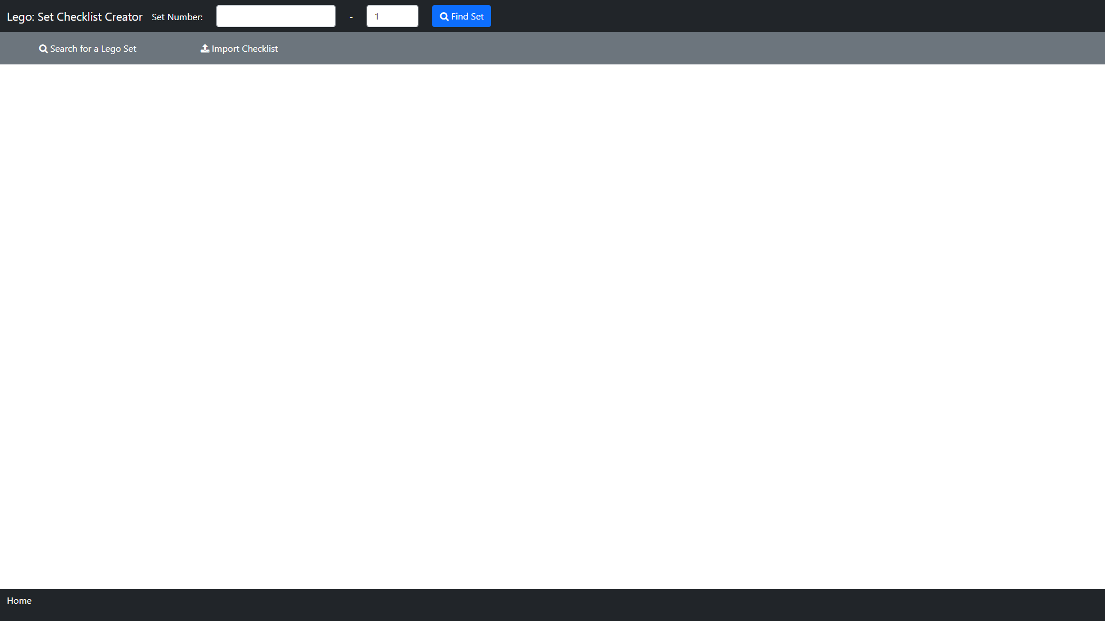
Index

Slide 5
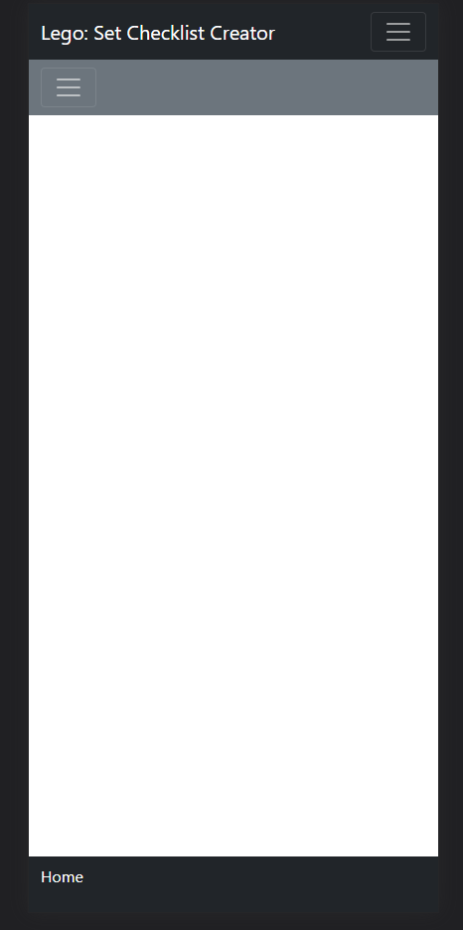
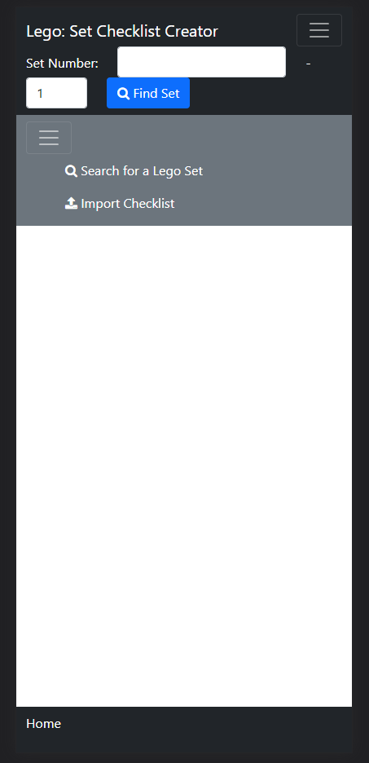
Index

Slide 6
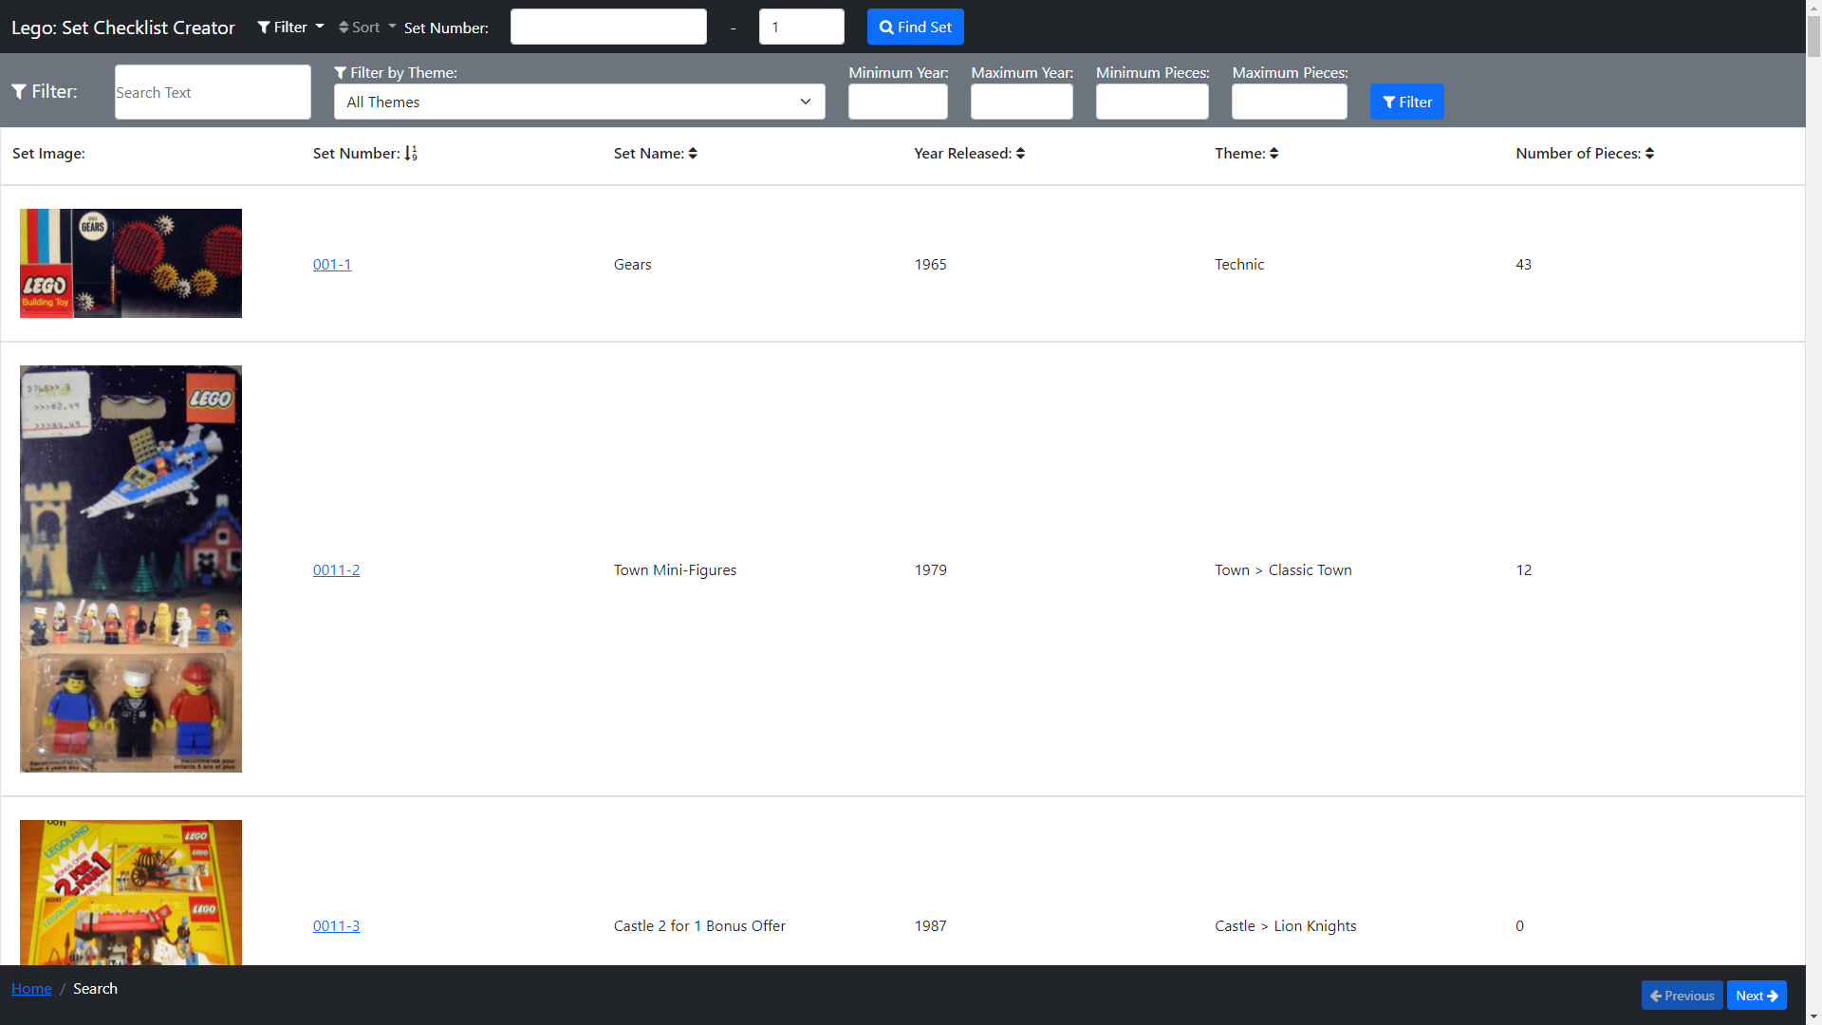
Search

Slide 7
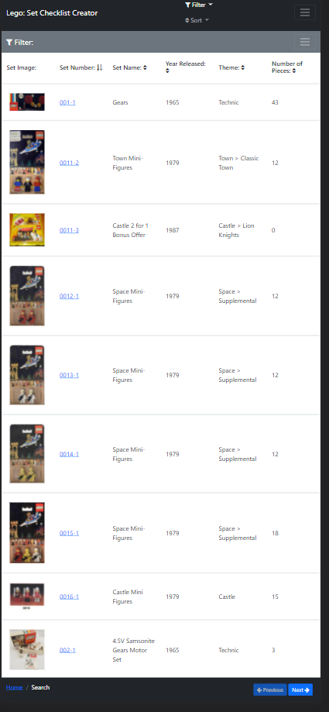
Search

Slide 8
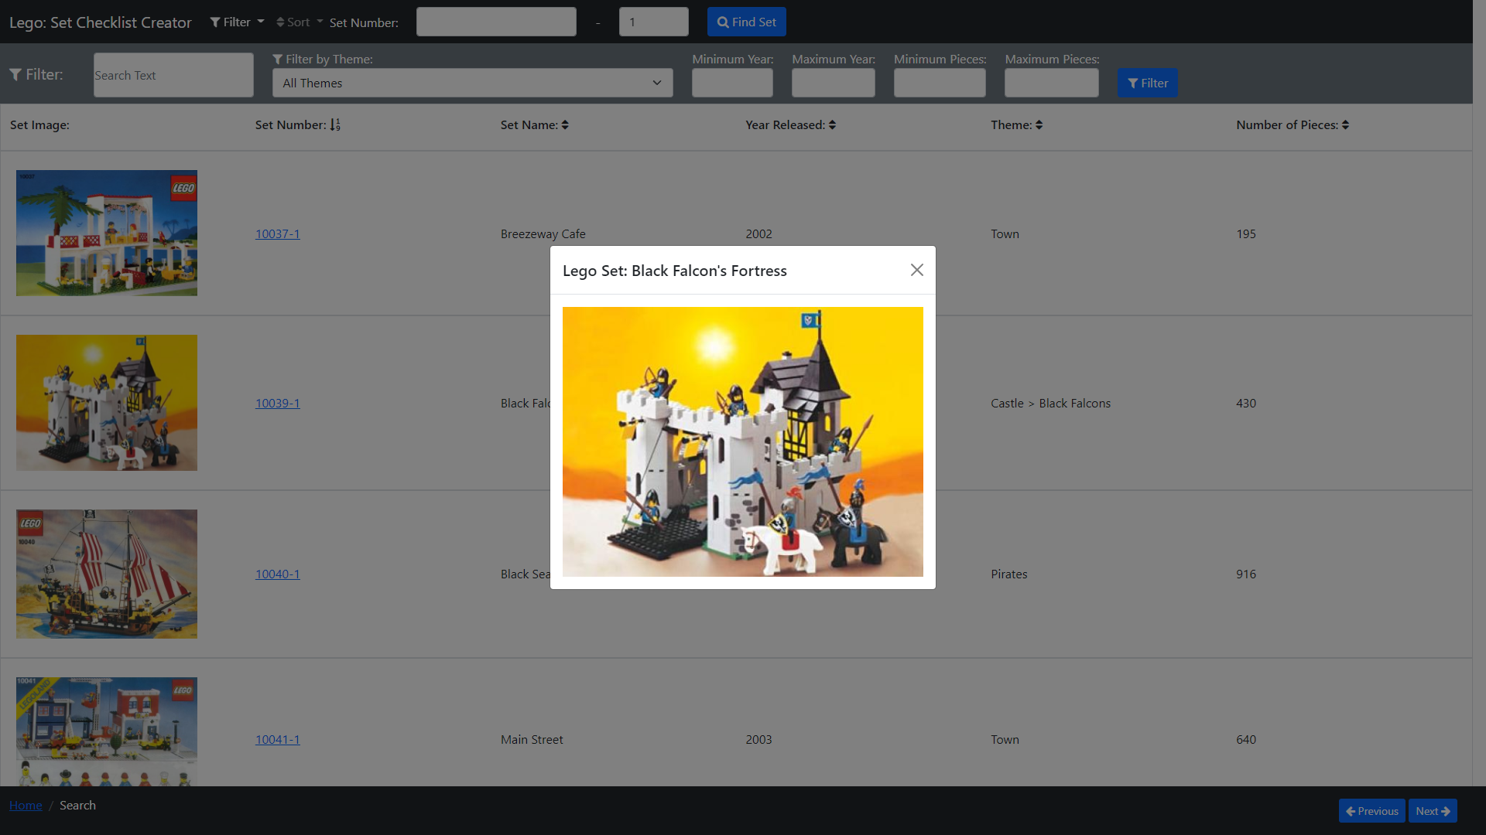
Search – Set Image

Slide 9
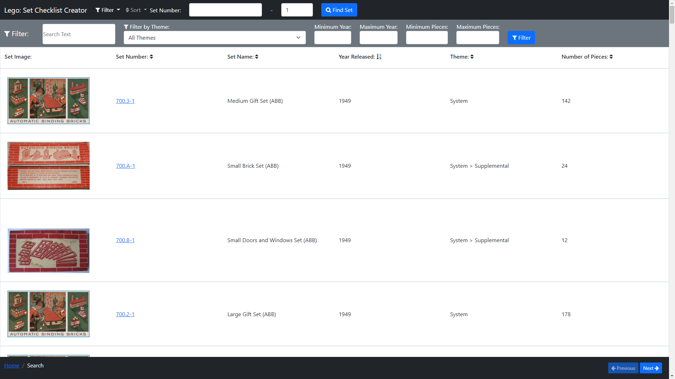
Search – Sort Column Year

Slide 10
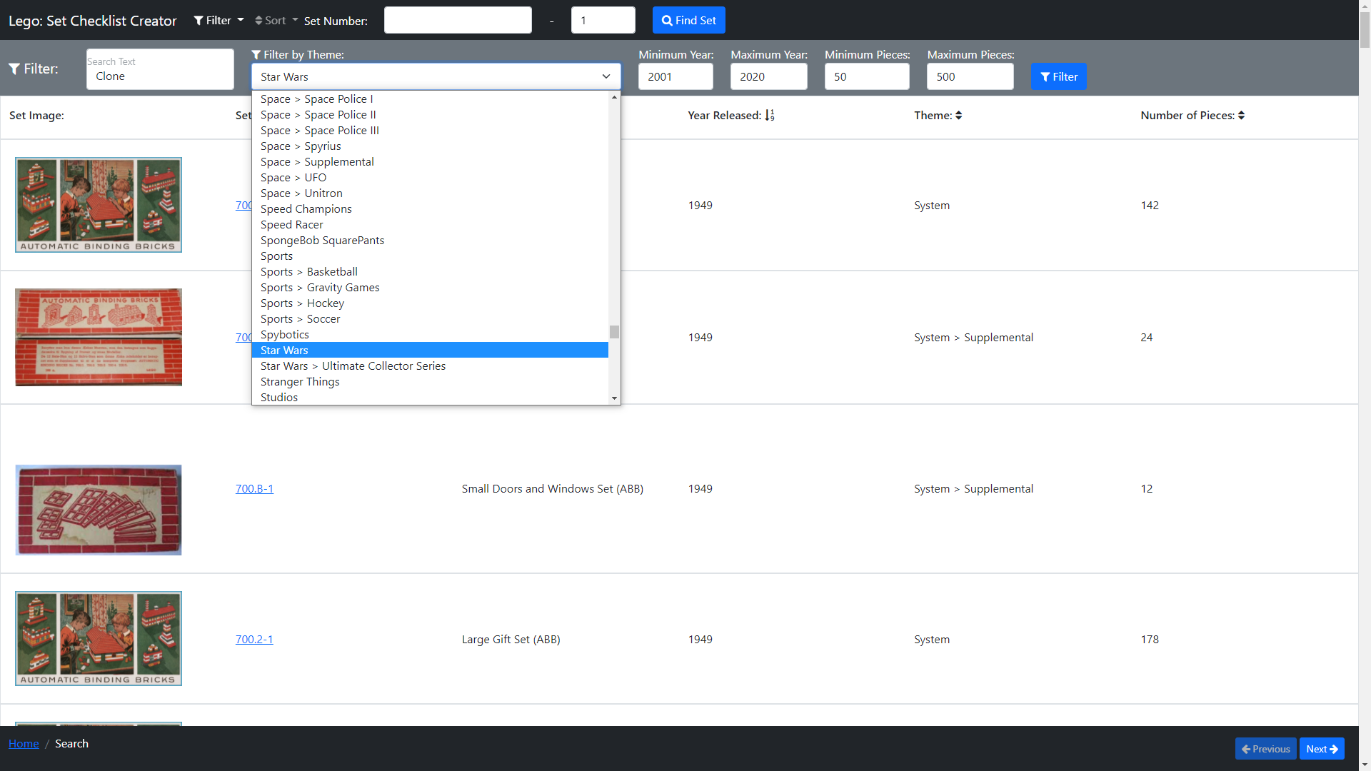
Search – Filter: Set Up

Slide 11
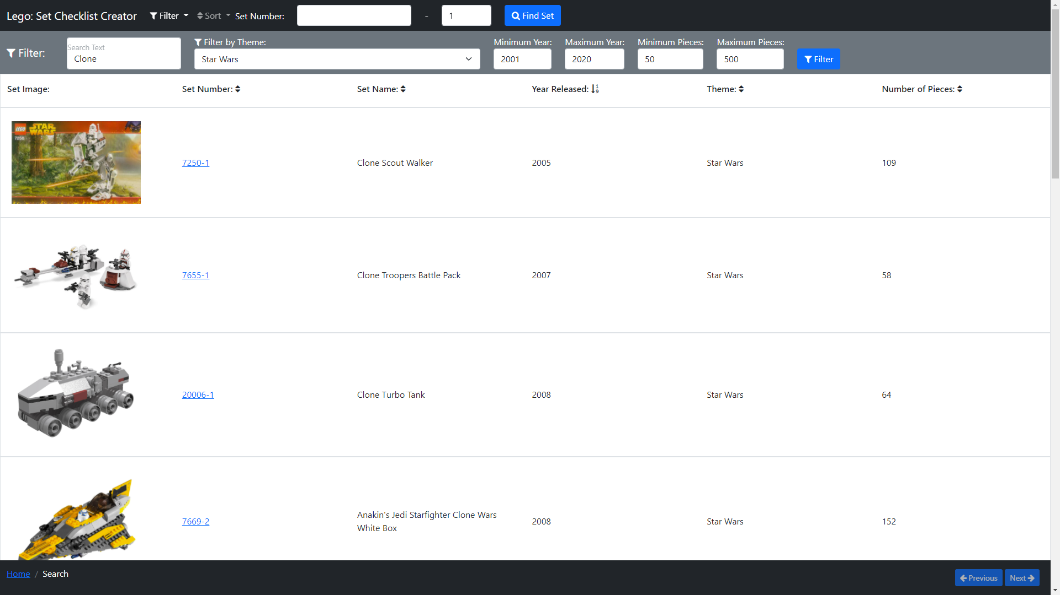
Search – Filtered

Slide 12
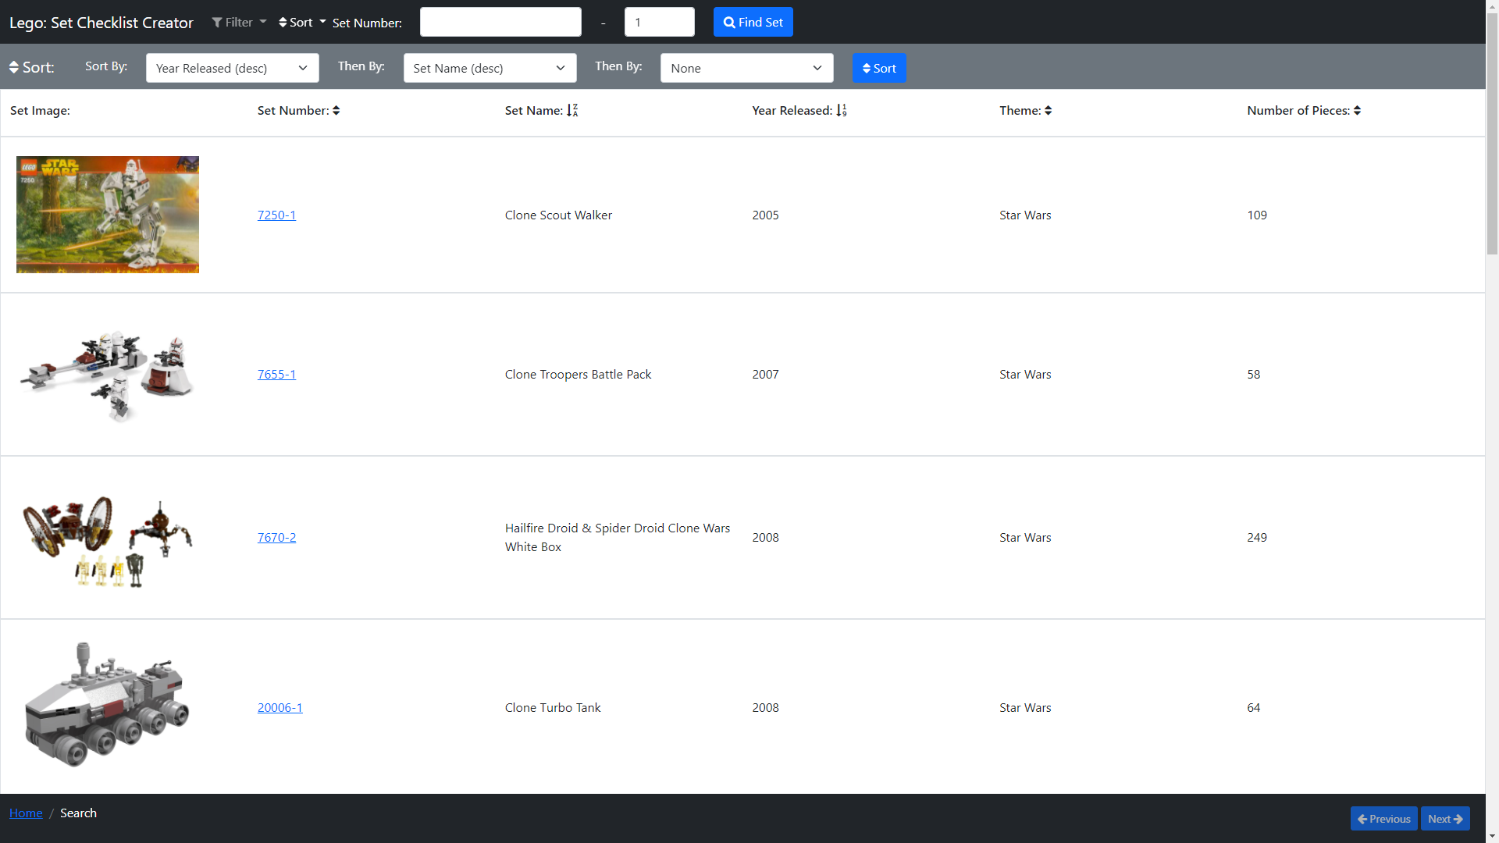
Search – Sort: year(asc), name(desc)

Slide 13
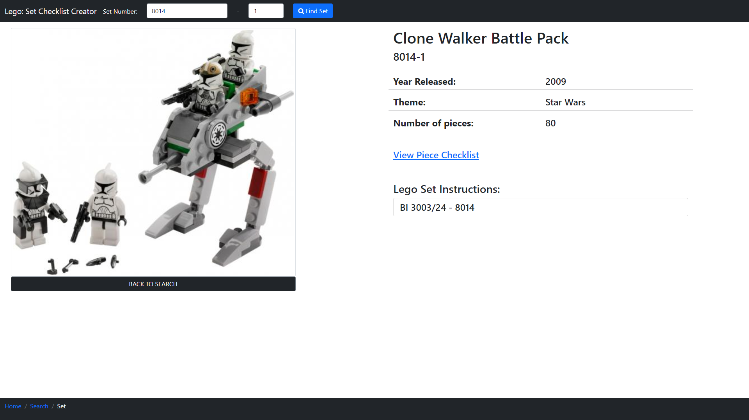
Lego Set – Clone Walker Battle Pack(8014-1)

Slide 14
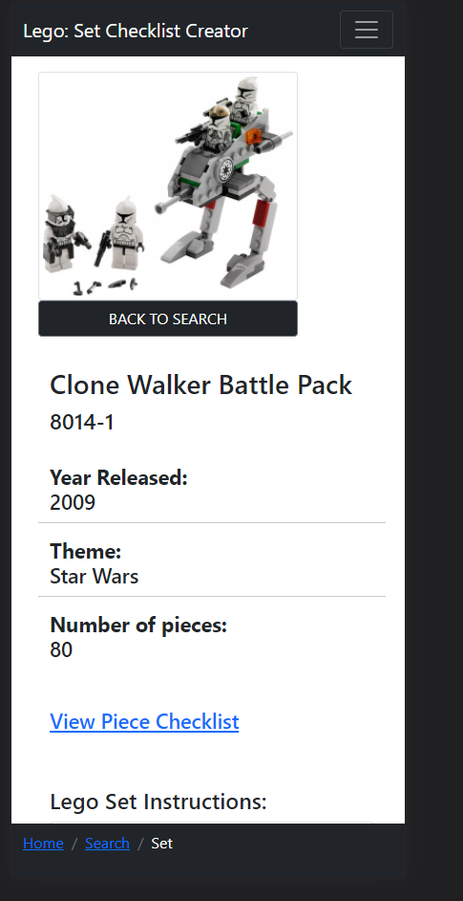
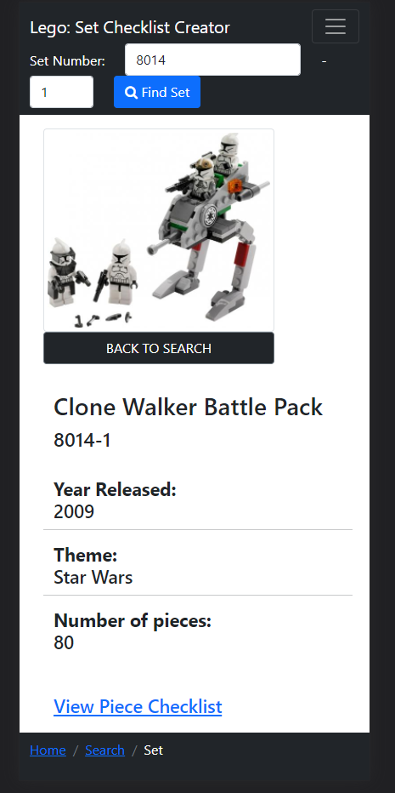
Lego Set – Clone Walker Battle Pack(8014-1)

Slide 15
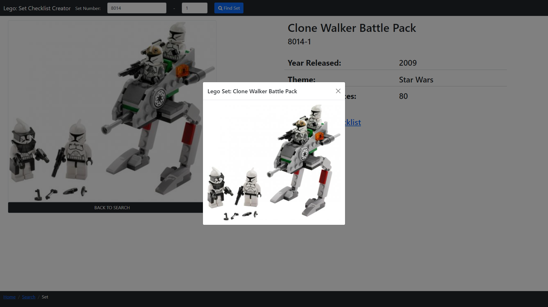
Lego Set – 8014-1 Set Image

Slide 16
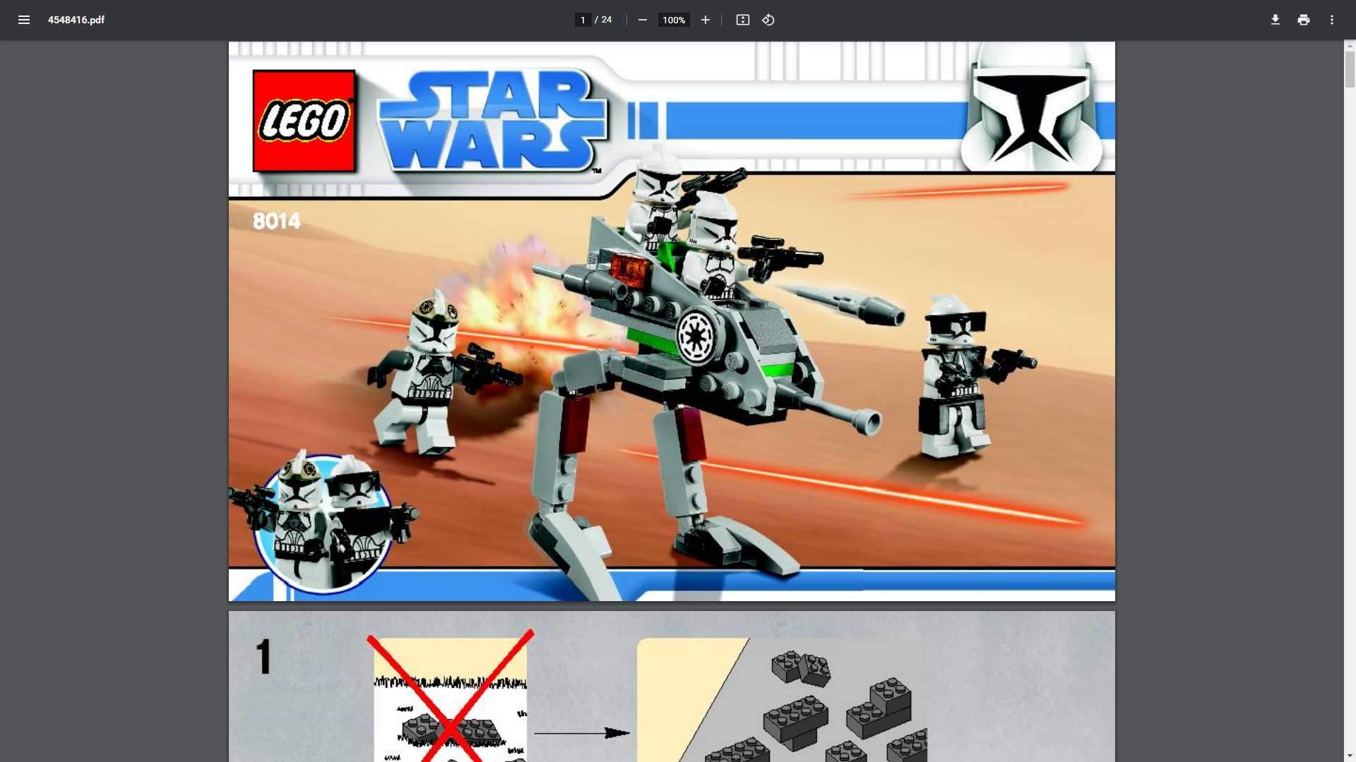
Lego Set – 8014-1 Instructions

Slide 17
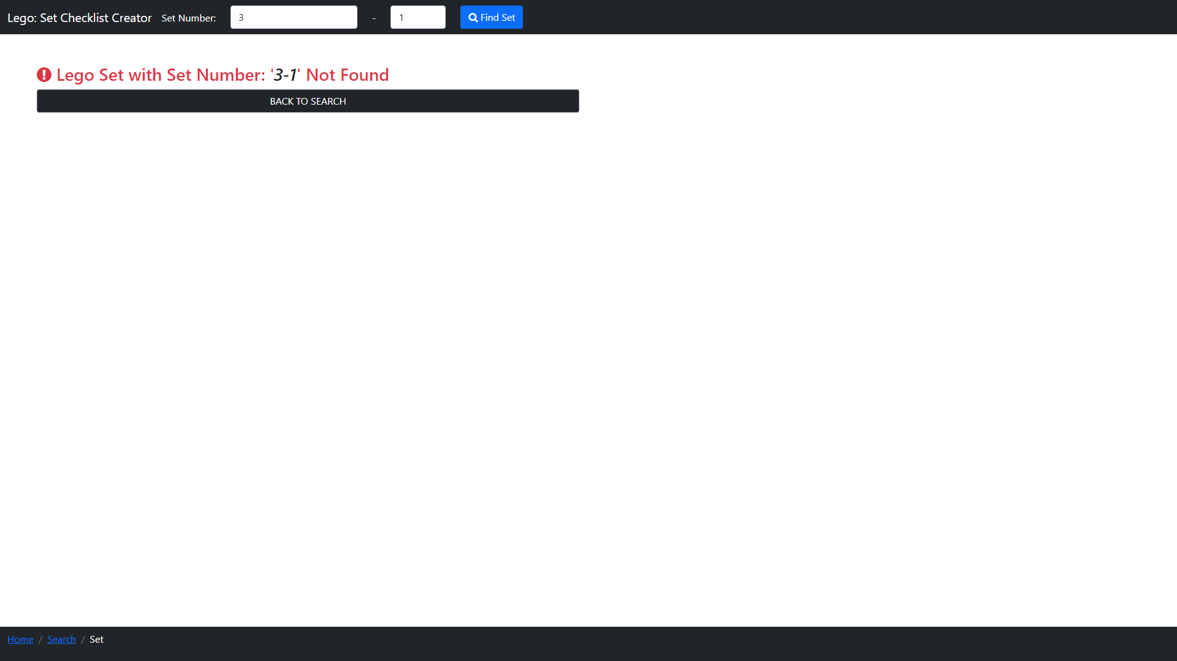
Lego Set – 3-1 Not Found

Slide 18
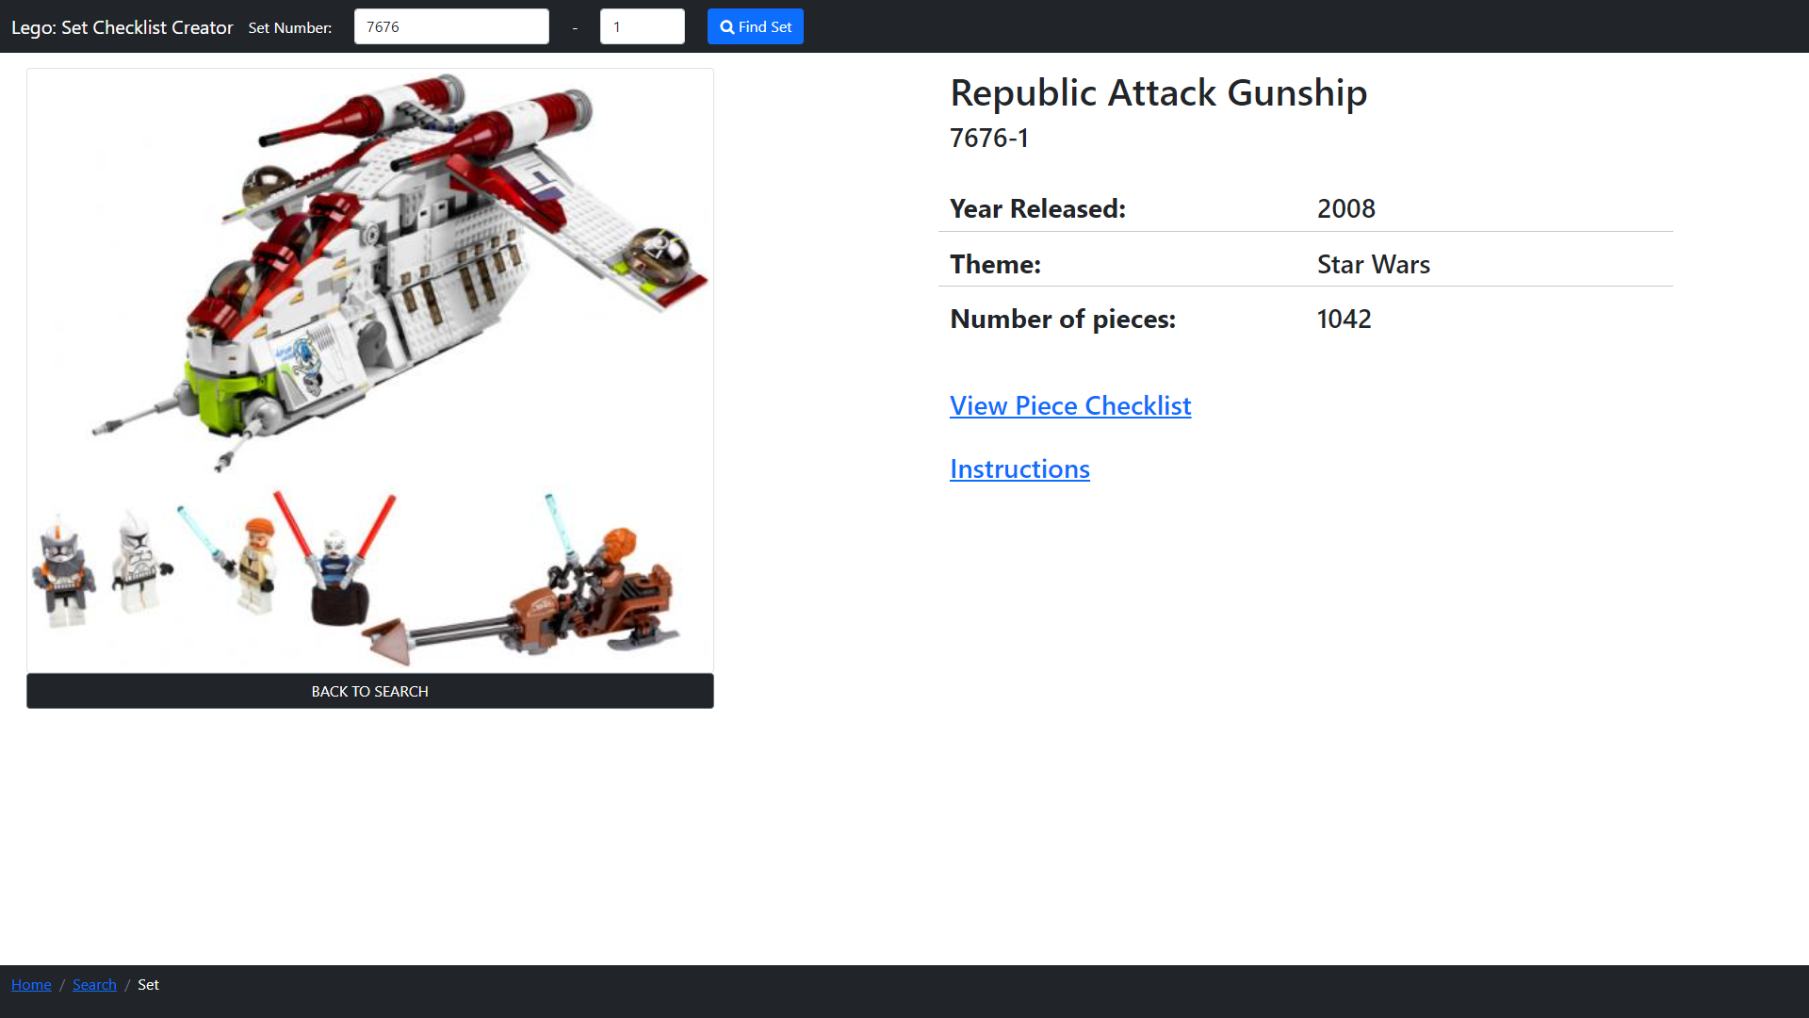
Lego Set – Republic Attack Gunship(7676-1)

Slide 19
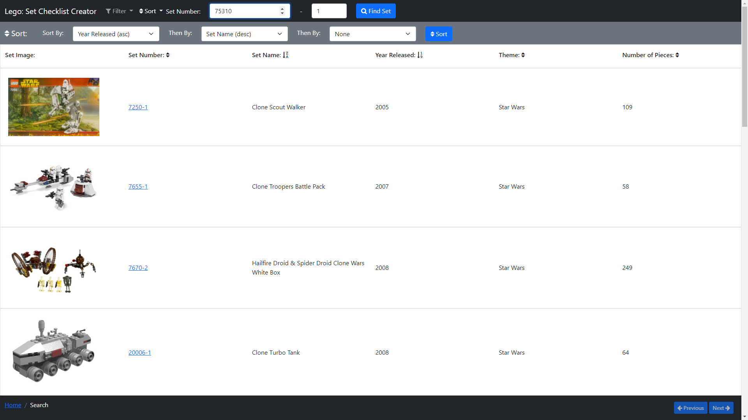
Search – Back To Search, Type Set Number 75310-1

Slide 20
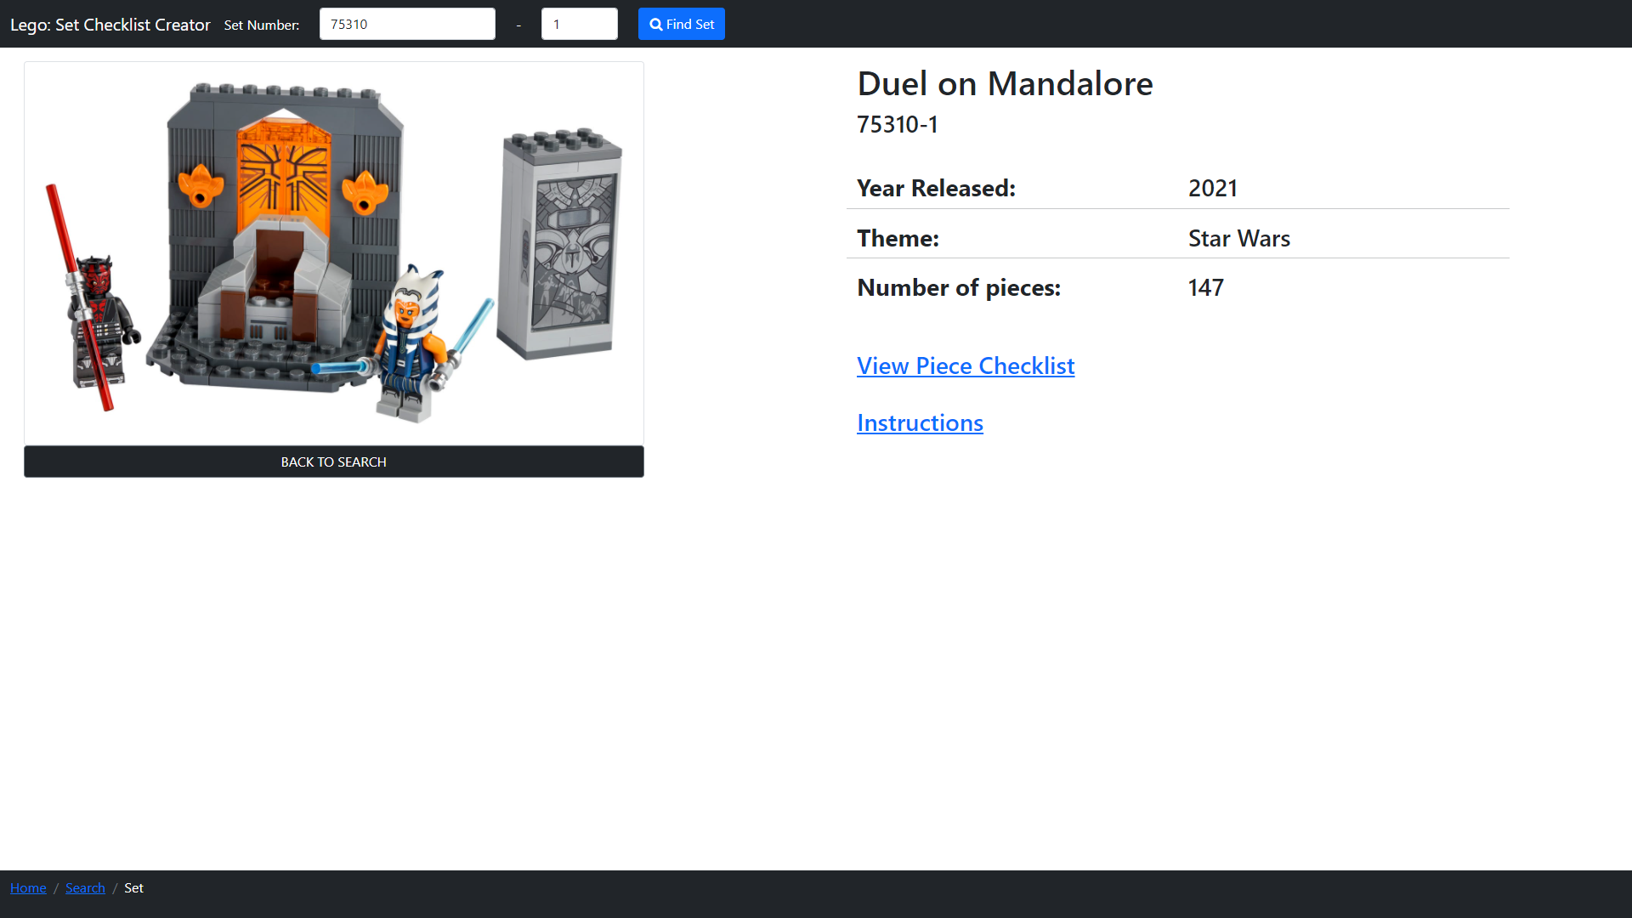
Lego Set – Duel on Mandalore(75310-1)

Slide 21
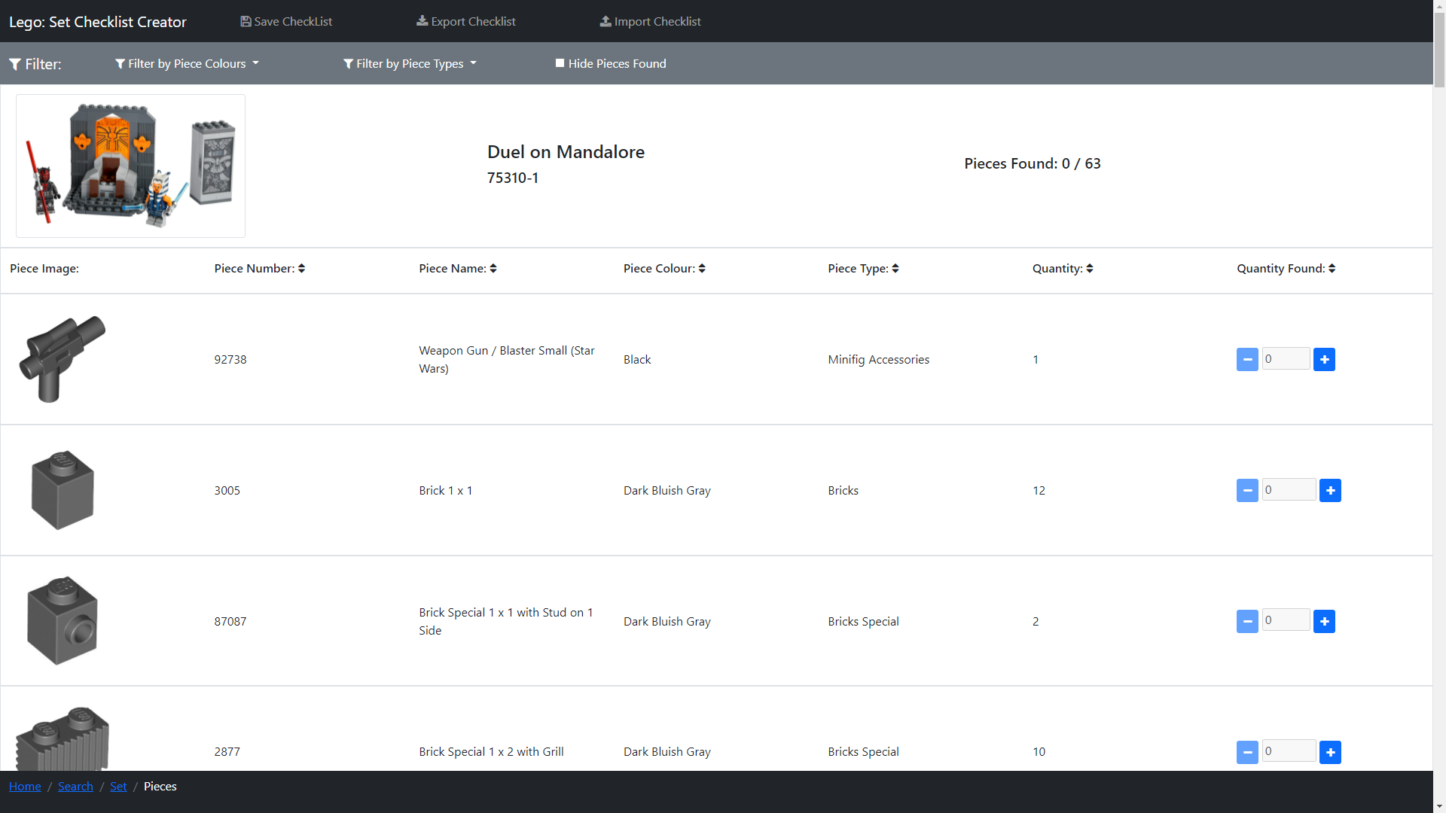
Lego Pieces – Duel on Mandalore(75310-1)

Slide 22
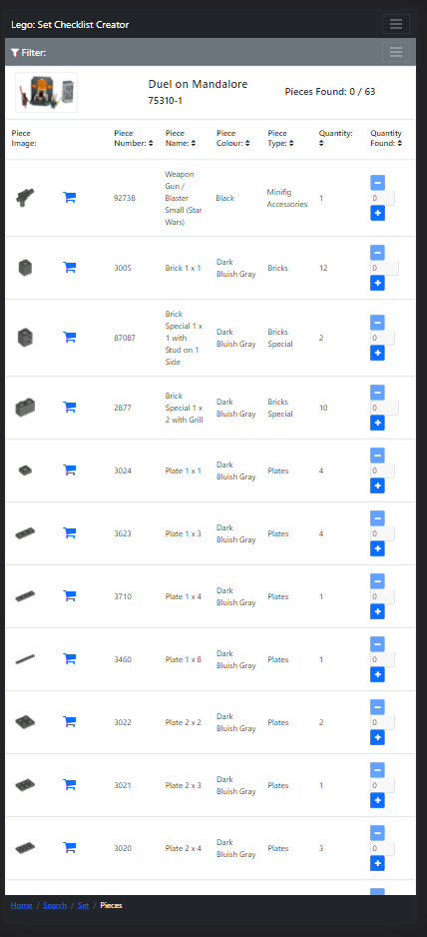
Lego Pieces – Duel on Mandalore(75310-1)

Slide 23
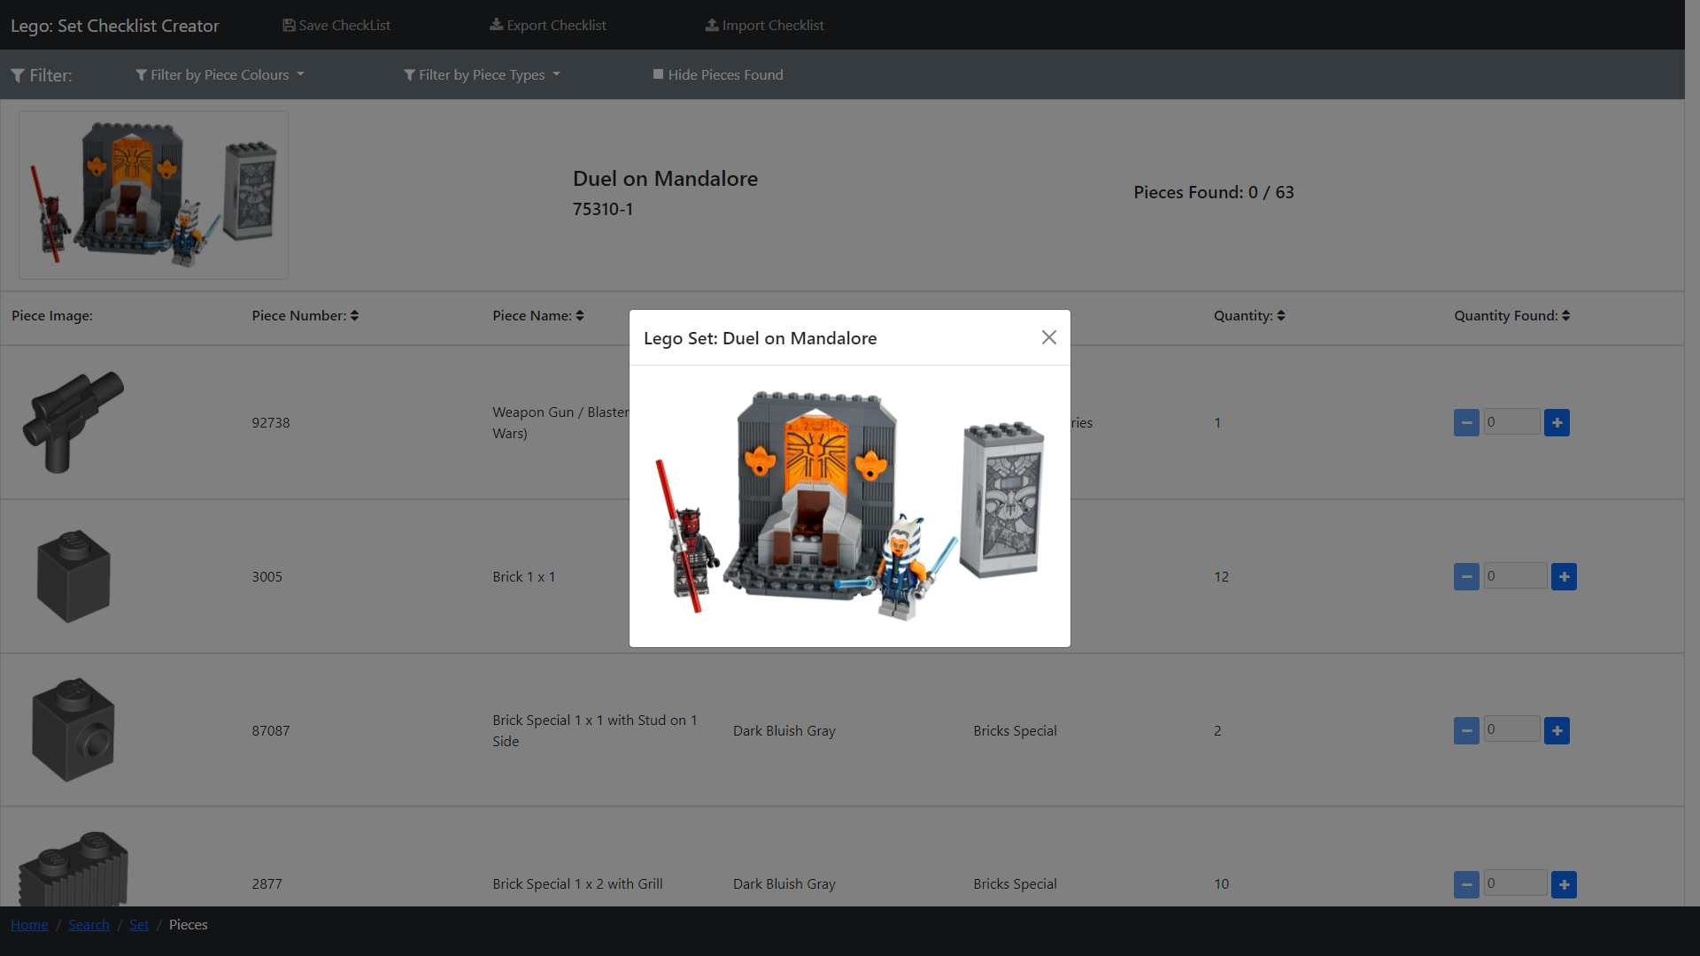
Lego Pieces – 75310-1 Set Image

Slide 24
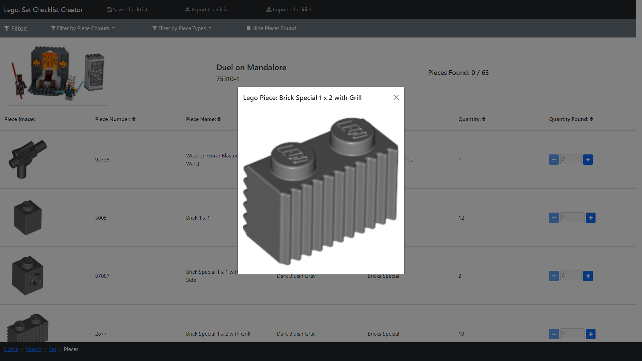
Lego Pieces – 75310-1 Piece Image

Slide 25
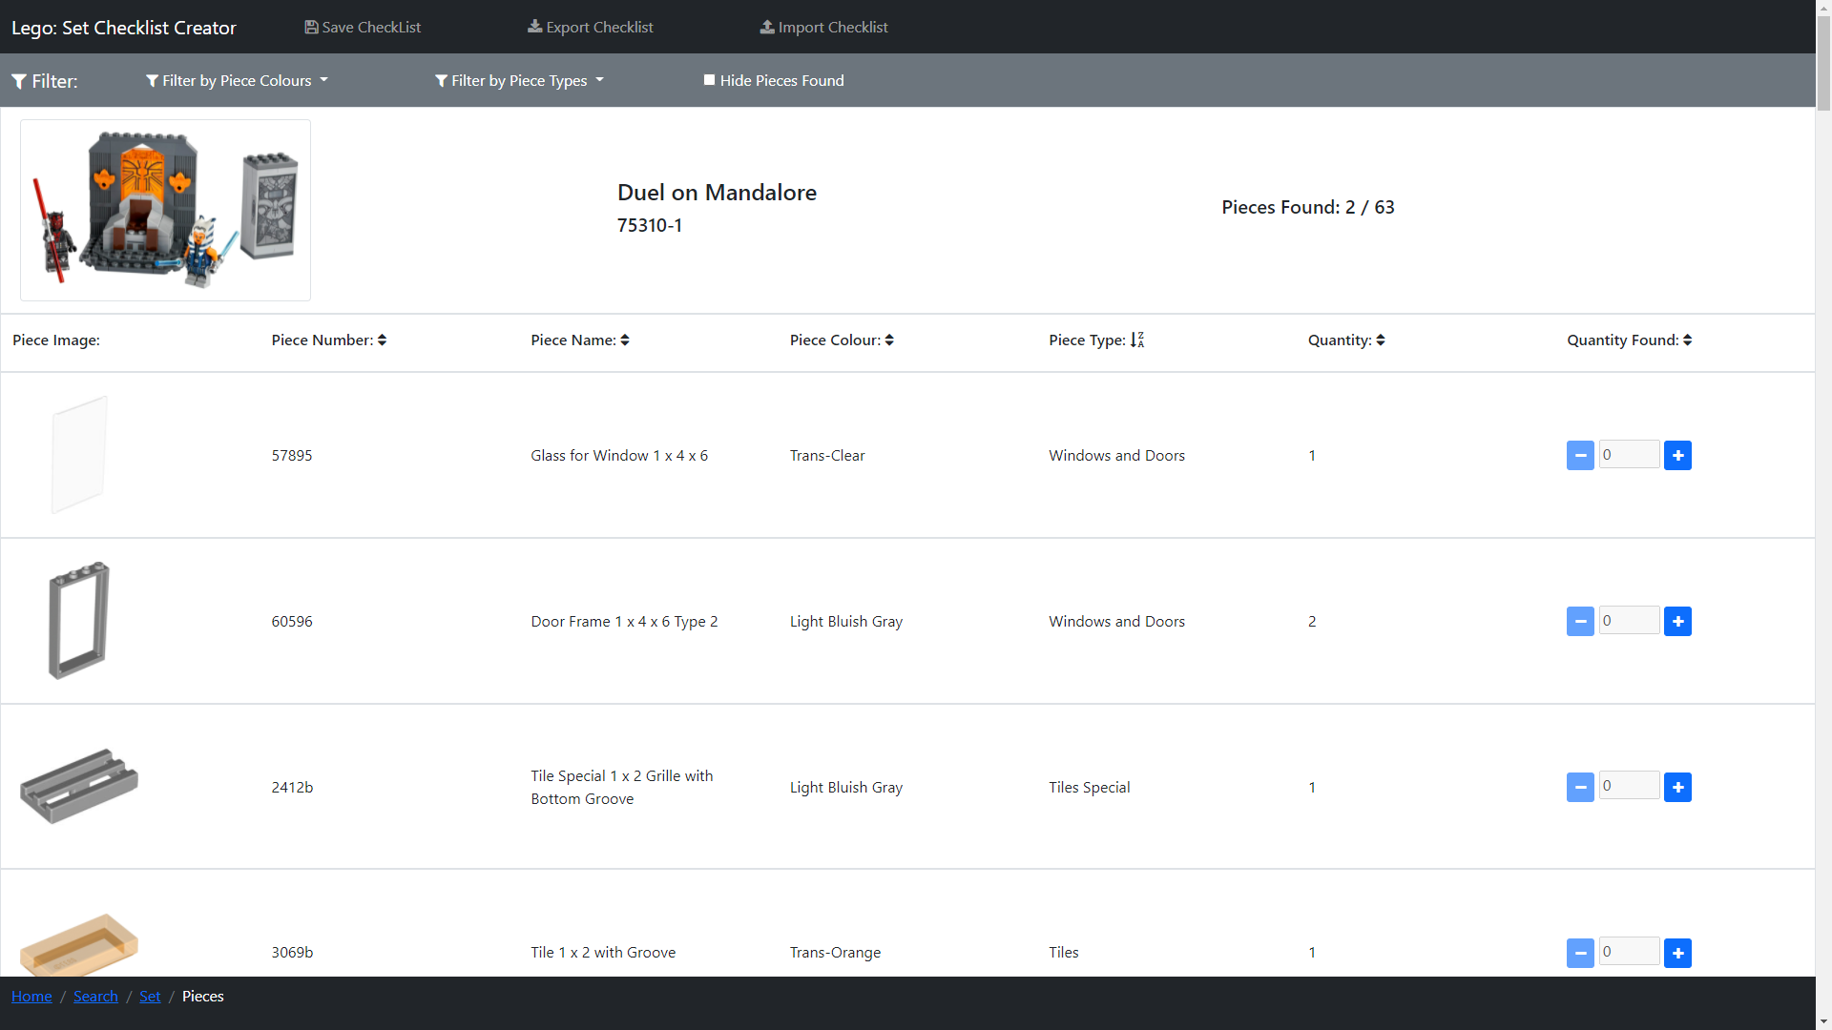
Lego Pieces – 75310-1 Sort

Slide 26
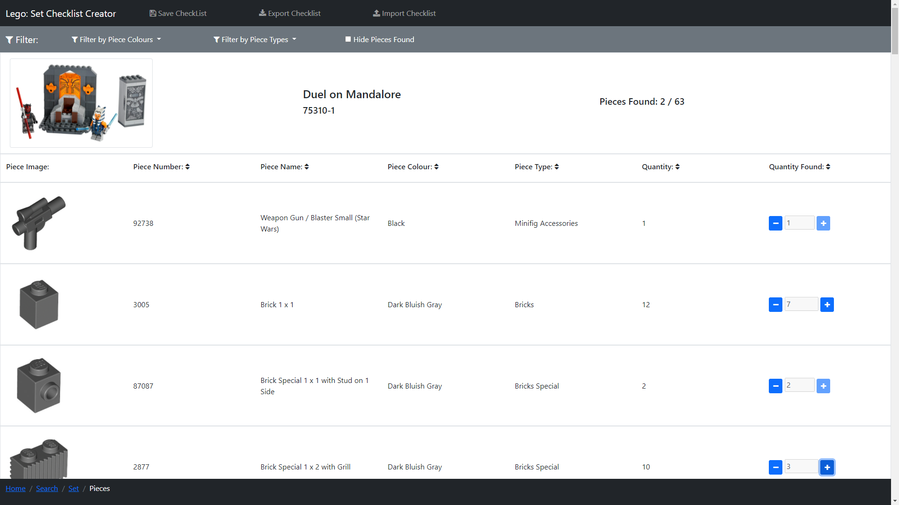
Lego Pieces – 75310-1 Checked Pieces

Slide 27
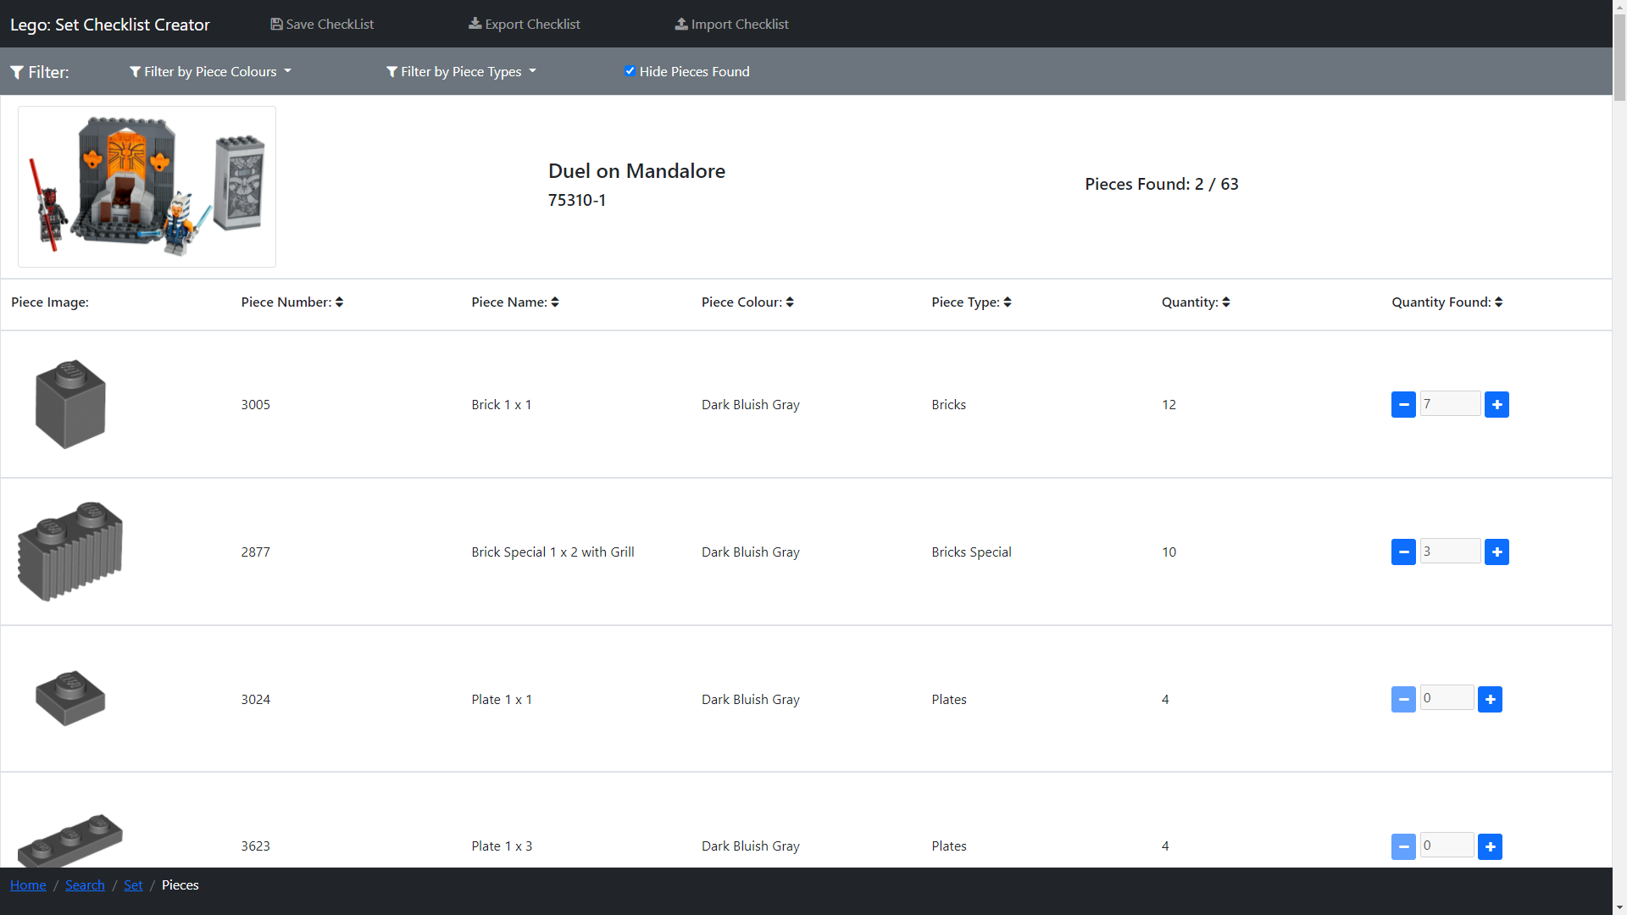
Lego Pieces – 75310-1 Hide Checked Pieces

Slide 28
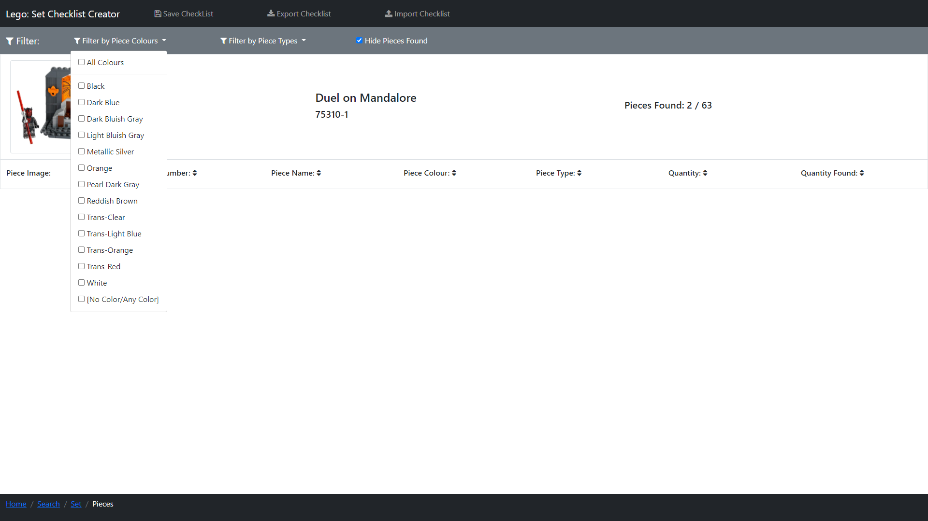
Lego Pieces – 75310-1 Filter: No Colours

Slide 29
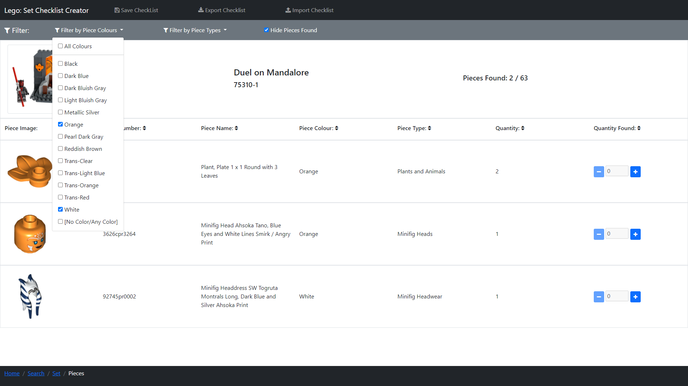
Lego Pieces – 75310-1 Filter: White & Orange

Slide 30
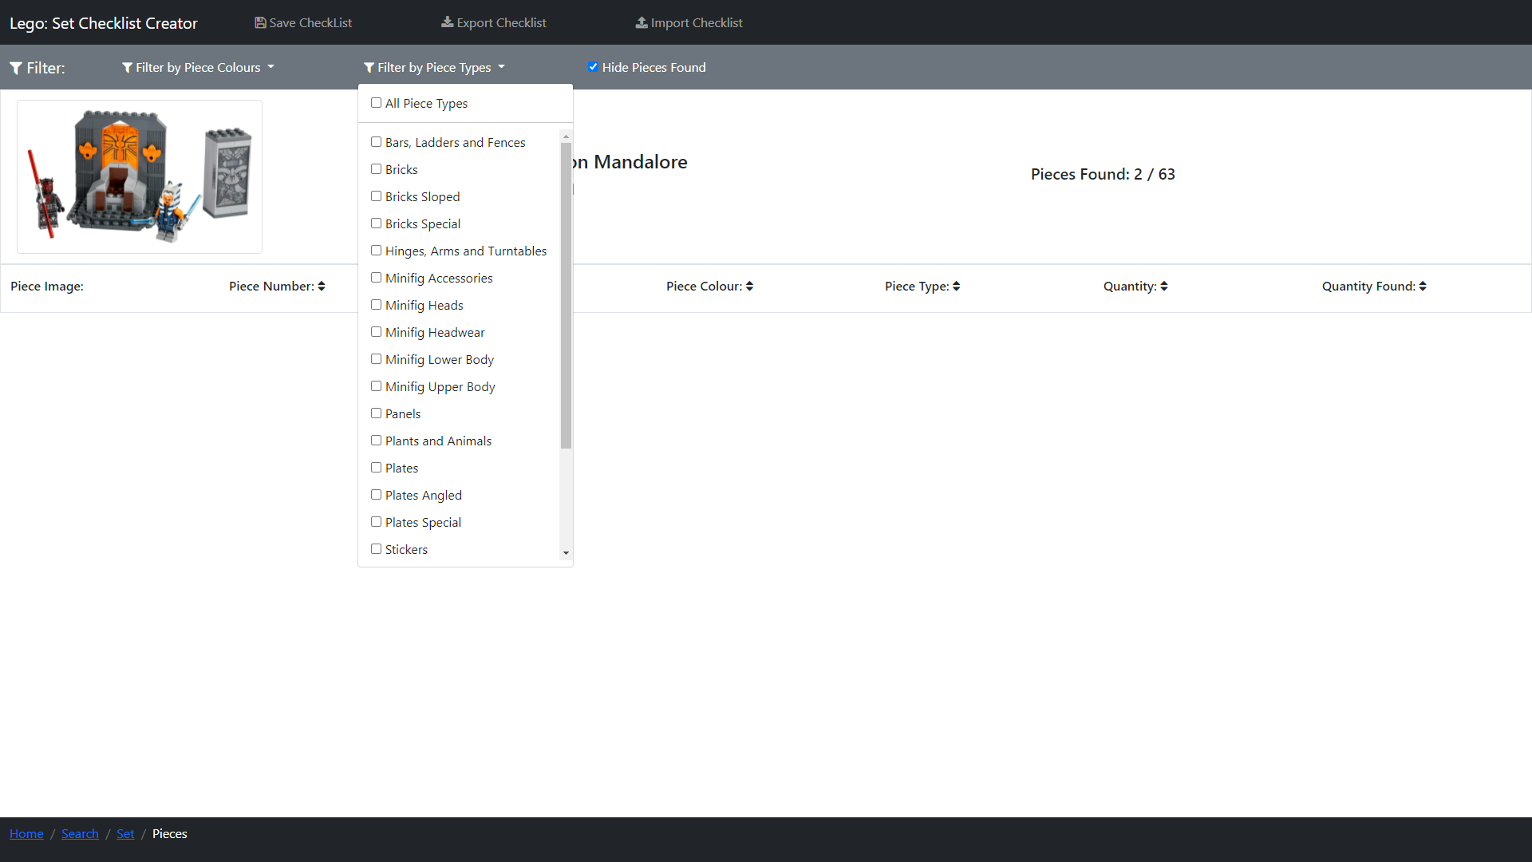
Lego Pieces – 75310-1 Filter: No Piece Types

Slide 31
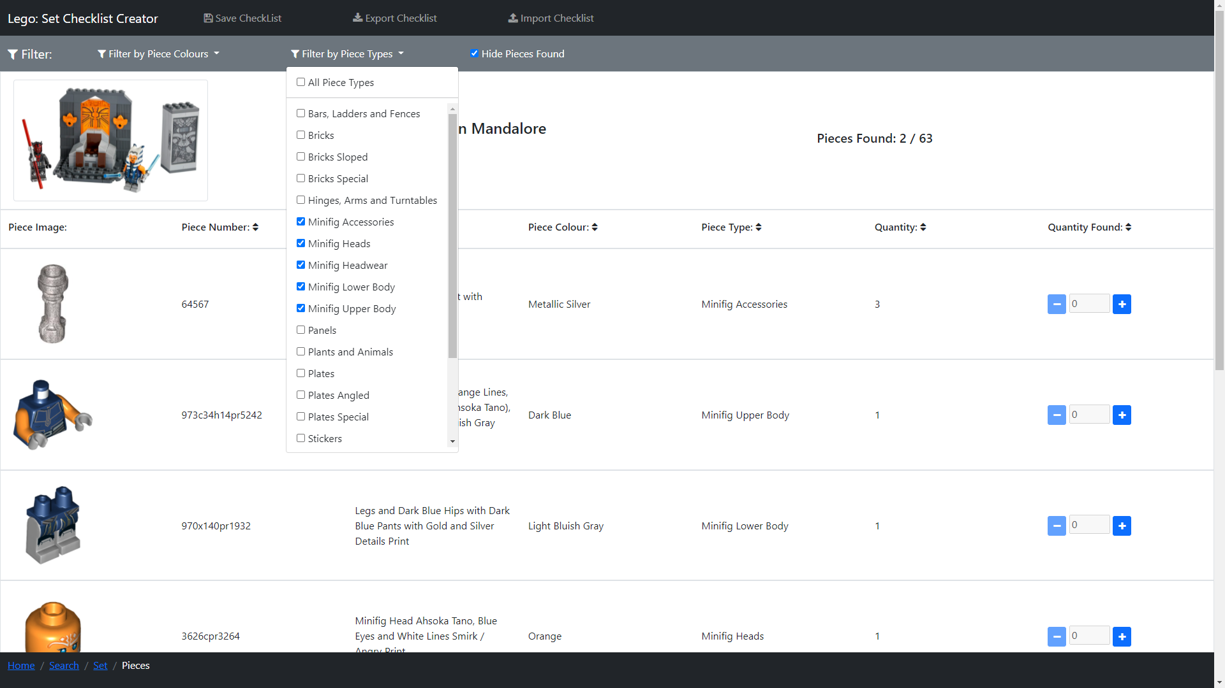
Lego Pieces – 75310-1 Filter: Minifigure Piece Types

Slide 32
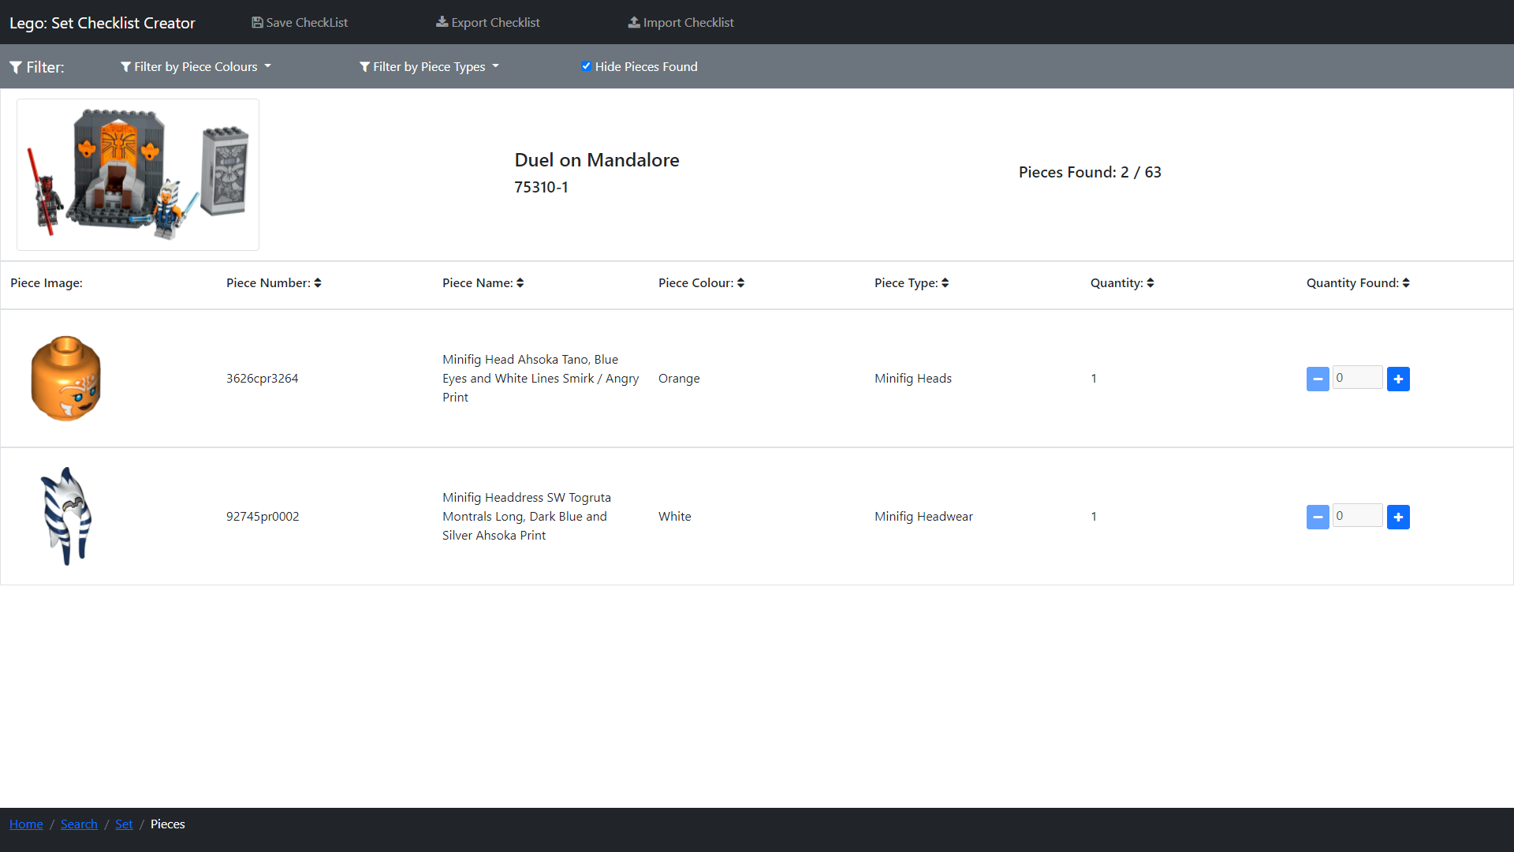
Lego Pieces – 75310-1 Filter: Colour & Type

Slide 33
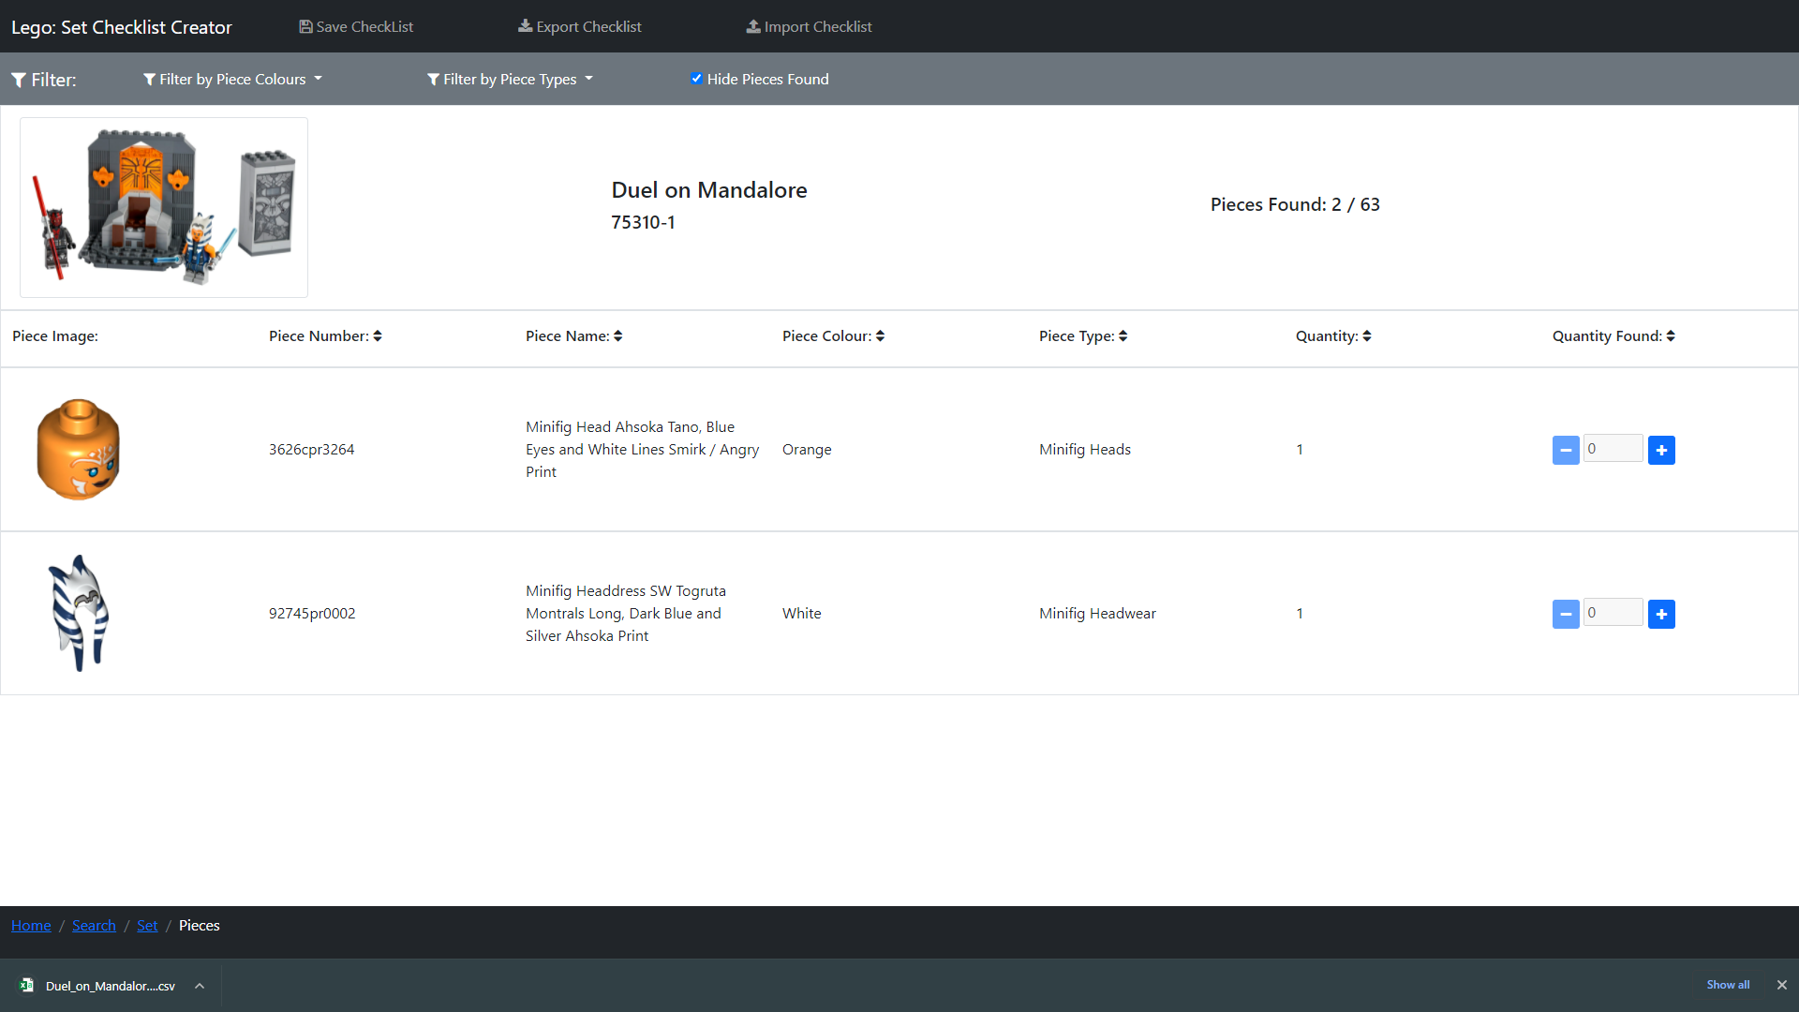
Lego Pieces – 75310-1 Export

Slide 34
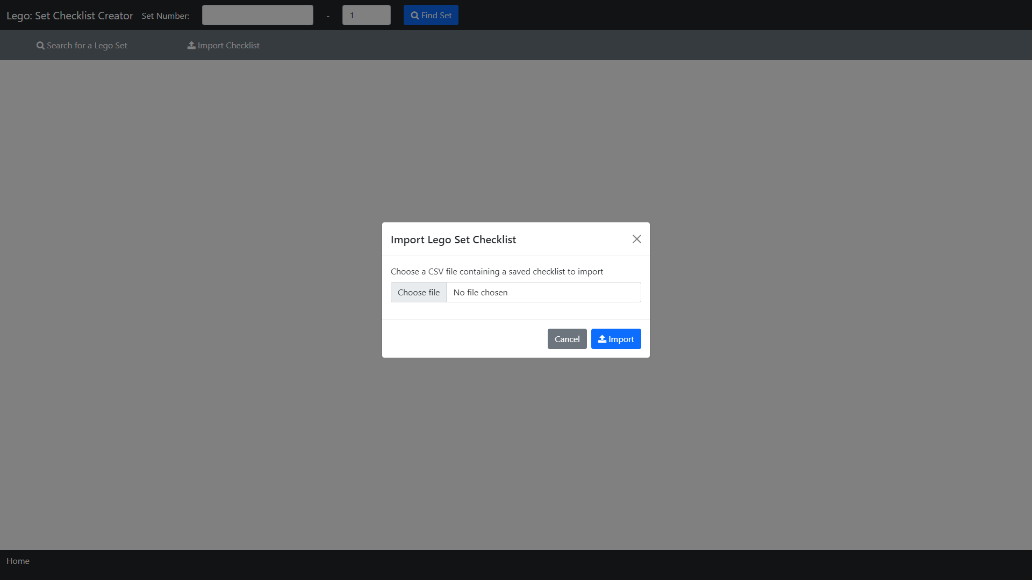
Index – Import 75310-1

Slide 35
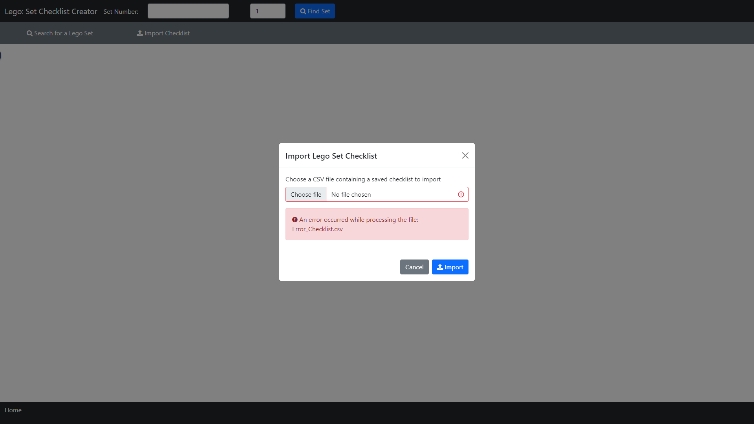
Index – Import 75310-1: Error Processing

Slide 36
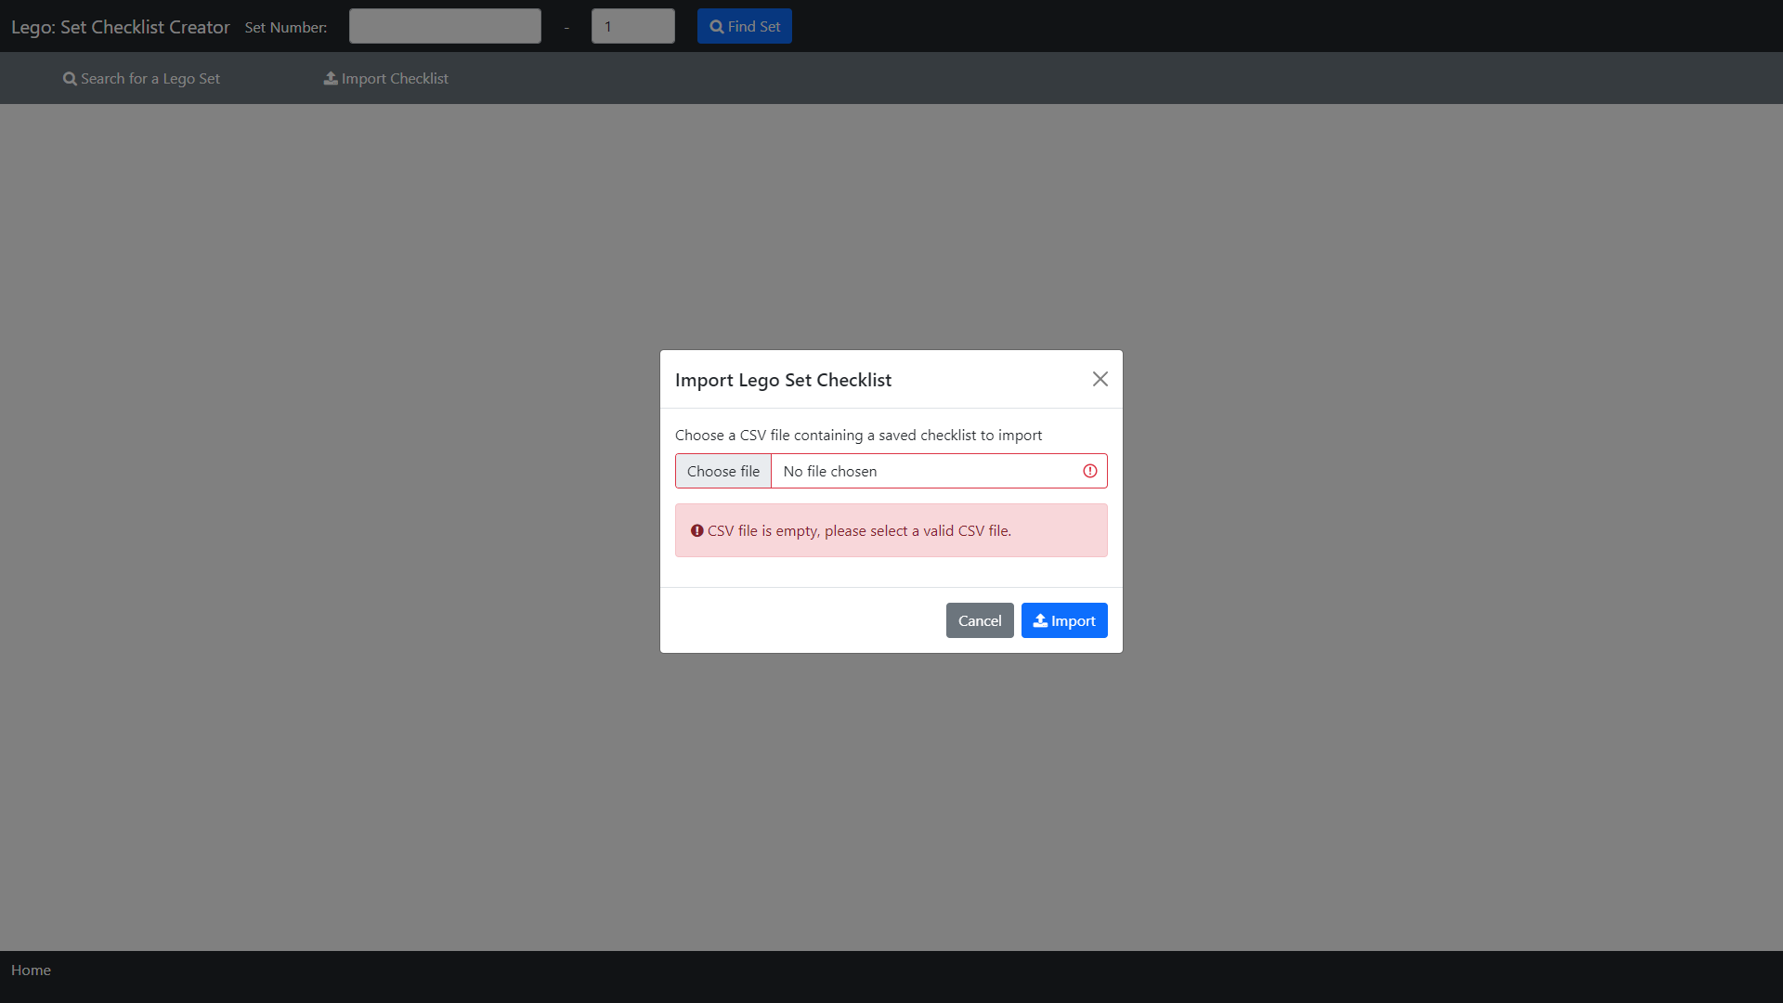
Index – Import 75310-1: Error CSV File Empty

Slide 37
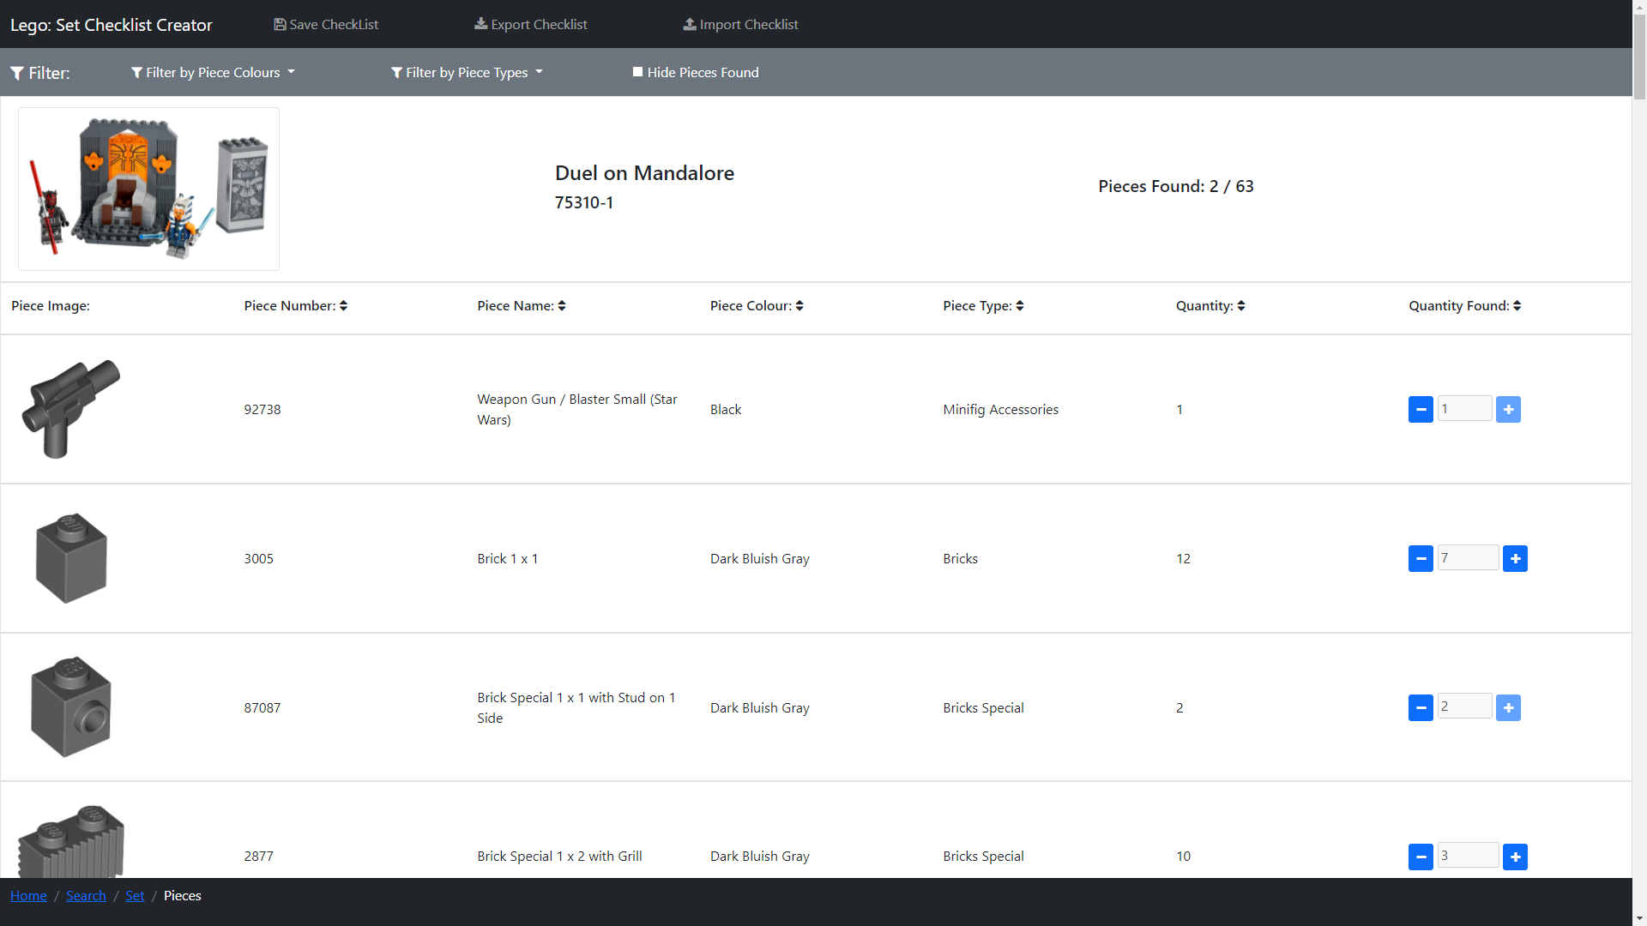
Lego Pieces – 75310-1 Imported Checklist

Slide 38
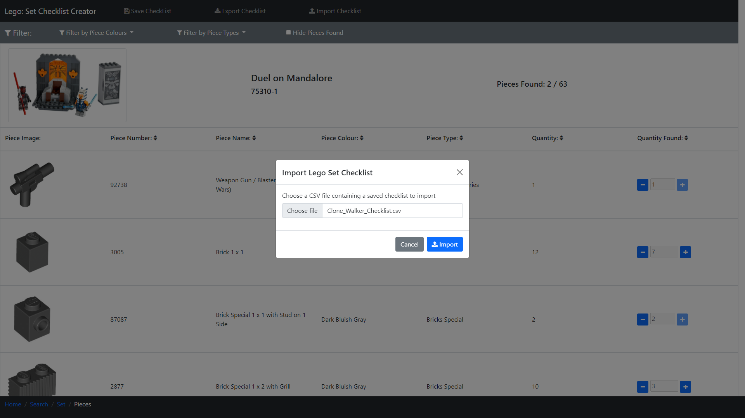
Lego Pieces – Import 30006-1

Slide 39
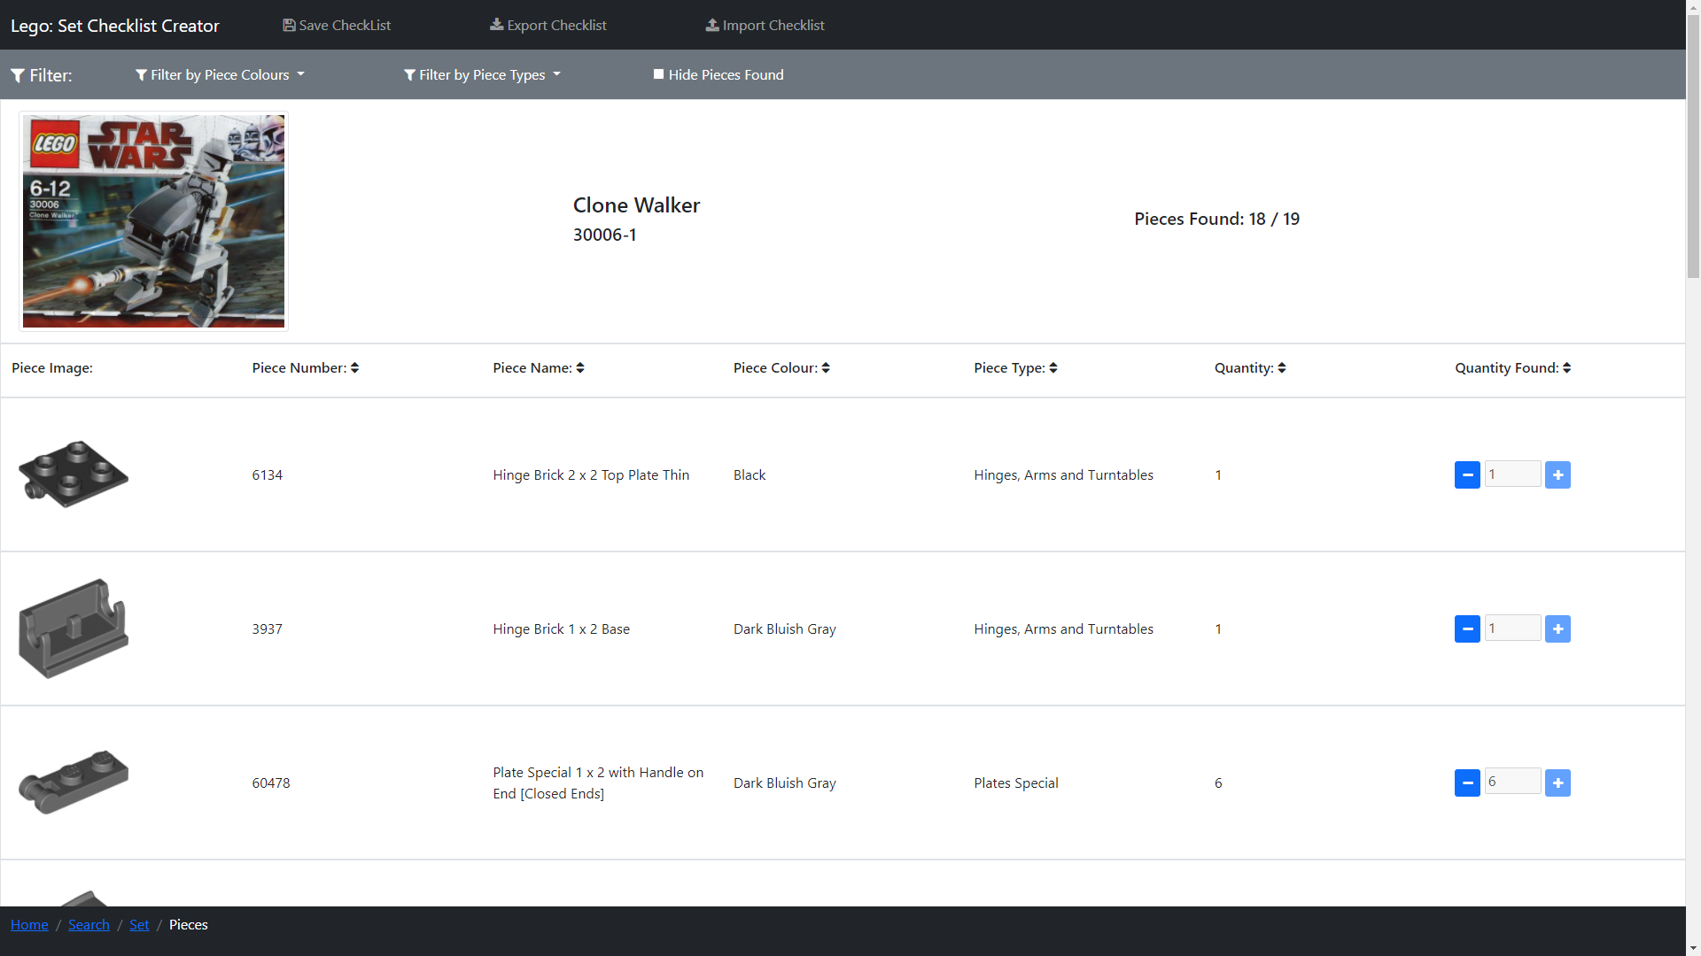
Lego Pieces – 30006-1 Imported Checklist

